Slide 1
5.6 The Pythagorean theorem

Slide 2
Introduction
In this topic, we will
Apply the Pythagorean theorem to vectors

Slide 3
The Pythagorean theorem
You already know the Pythagorean theorem:
Given a right-angled triangle with sides of length a, b and c,
then a² + b² = c²
a
c
b

Slide 4
Orthogonality
Now, given two vectors u and v, is there a relationship between ||u||₂, ||v||₂, and ||u + v||₂?
u + v
u + v
u
u
v
v

Slide 5
Orthogonality
What if the two vectors u and v are orthogonal?
Hypothesis: Is ?
u + v
v
u

Slide 6
Orthogonality
Theorem
If , then .
Proof:
Recall that ,
Thus
0
0
▮

Slide 7
Orthogonality
Thus, if the vectors u and v are orthogonal:
u + v
v
u

Slide 8
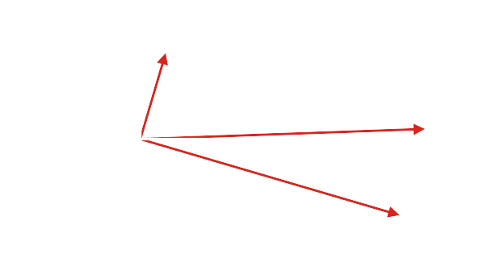
Example
For example, and are orthogonal

Slide 9
Summary
Following this topic, you now
Understand the Pythagorean theorem applies to orthogonal vectors
Understand the proof
Have seen an example in R²

Slide 10
References
[1] https://en.wikipedia.org/wiki/Orthogonality

Slide 11
Acknowledgments
None so far.

Slide 12
Colophon
These slides were prepared using the Cambria typeface. Mathematical equations use Times New Roman, and source code is presented using Consolas.
The photographs of flowers and a monarch butter appearing on the title slide and accenting the top of each other slide were taken at the Royal Botanical Gardens in October of 2017 by Douglas Wilhelm Harder. Please see
https://www.rbg.ca/
for more information.

Slide 13
Disclaimer
These slides are provided for the ne 112 Linear algebra for nanotechnology engineering course taught at the University of Waterloo. The material in it reflects the authors’ best judgment in light of the information available to them at the time of preparation. Any reliance on these course slides by any party for any other purpose are the responsibility of such parties. The authors accept no responsibility for damages, if any, suffered by any party as a result of decisions made or actions based on these course slides for any other purpose than that for which it was intended.

